Slide 1
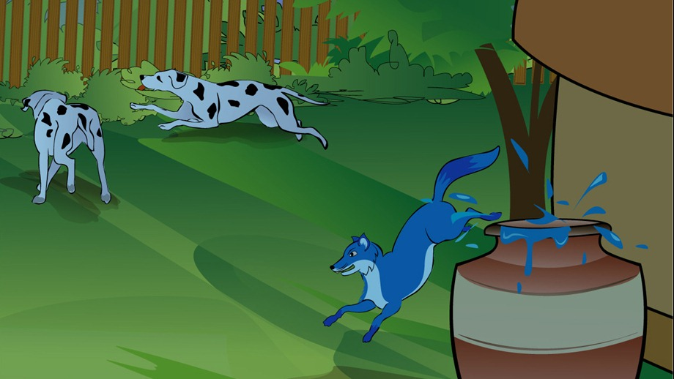
The Story of the Blue Jackal The Story of the Blue Jackal The Story of the Blue Jackal The Story of the Blue Jackal
Tales of Panchatantra,
Kochi, India
* E-mail: panchatantra@panchatantra.com
PO 35
Sub heading
Sub heading
Sub heading
Once, there lived a jackal named Chandarava.
One day he was very hungry, and could not find any food. Story Of The Blue Jackal - Panchatantra Story PictureSo, he wandered into a nearby village in search of food.
The dogs in the village saw the jackal, and a group of dogs surrounded him, barking and attacking with their sharp teeth.
The jackal started running to save itself, but the dogs chased.
In an attempt to flee from the dogs, he ran into a house, which belonged to a washerman.
There was a big vat of blue dye inside.
The jackal started running to save itself, but the dogs chased.
In an attempt to flee from the dogs, he ran into a house, which belonged to a washerman.
There was a big vat of blue dye inside.
Once, there lived a jackal named Chandarava.
One day he was very hungry, and could not find any food. Story Of The Blue Jackal - Panchatantra Story PictureSo, he wandered into a nearby village in search of food.
The dogs in the village saw the jackal, and a group of dogs surrounded him, barking and attacking with their sharp teeth.
The jackal started running to save itself, but the dogs chased.
In an attempt to flee from the dogs, he ran into a house, which belonged to a washerman.
There was a big vat of blue dye inside.
Once, there lived a jackal named Chandarava.
One day he was very hungry, and could not find any food. Story Of The Blue Jackal - Panchatantra Story PictureSo, he wandered into a nearby village in search of food.
The dogs in the village saw the jackal, and a group of dogs surrounded him, barking and attacking with their sharp teeth.
The jackal started running to save itself, but the dogs chased.
In an attempt to flee from the dogs, he ran into a house, which belonged to a washerman.
There was a big vat of blue dye inside.
Sub heading
Sub heading
Once, there lived a jackal named Chandarava.
One day he was very hungry, and could not find any food. Story Of The Blue Jackal - Panchatantra Story PictureSo, he wandered into a nearby village in search of food.
The dogs in the village saw the jackal, and a group of dogs surrounded him, barking and attacking with their sharp teeth.
The jackal started running to save itself, but the dogs chased.
In an attempt to flee from the dogs, he ran into a house, which belonged to a washerman.
There was a big vat of blue dye inside.
To evaluate the Influence of bathymetry/topography on the formation of potential fishing zone in Laccadive sea
Once, there lived a jackal named Chandarava.
One day he was very hungry, and could not find any food. Story Of The Blue Jackal - Panchatantra Story PictureSo, he wandered into a nearby village in search of food.
The dogs in the village saw the jackal, and a group of dogs surrounded him, barking and attacking with their sharp teeth.
The jackal started running to save itself, but the dogs chased.
In an attempt to flee from the dogs, he ran into a house, which belonged to a washerman.
There was a big vat of blue dye inside.
To evaluate the Influence of bathymetry/topography on the formation of potential fishing zone in Laccadive sea
Once, there lived a jackal named Chandarava.
One day he was very hungry, and could not find any food. Story Of The Blue Jackal - Panchatantra Story PictureSo, he wandered into a nearby village in search of food.
The dogs in the village saw the jackal, and a group of dogs surrounded him, barking and attacking with their sharp teeth.
Sub heading
Once, there lived a jackal named Chandarava.
One day he was very hungry, and could not find any food. Story Of The Blue Jackal - Panchatantra Story PictureSo, he wandered into a nearby village in search of food.
The dogs in the village saw the jackal, and a group of dogs surrounded him, barking and attacking with their sharp teeth.
Once, there lived a jackal named Chandarava.
One day he was very hungry, and could not find any food. Story Of The Blue Jackal - Panchatantra Story PictureSo, he wandered into a nearby village in search of food.

